Slide 1
Integrity Overview
PTC Korea

Slide 2
1. 회사 소개
1. 회사 소개
2. 소프트웨어 시장 규모
3. ISO 26262 소개
4. ALM 및 Integrity 소개

Slide 3
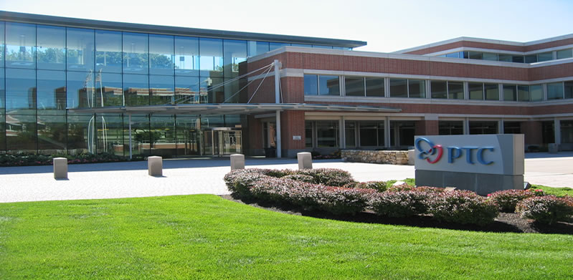
회사 소개
회사명
PTC (NASDAQ : PMTC)
총 임직원 수
6,262 여명 (FY12 기준)
소재지
본사 : 미 매사츄세츠 주 Needham ,총 26개국 87개 지사
년 매출
US$ 1,630 Million (FY11 기준)
고객 현황
전세계 50,000여 고객사 보유
Identify Value
Best practices
Optimize
Plan
1,900 employees in R&D
575 employees in QA
Program governance
Value scorecard
CUSTOMER VALUE
1,450 service professionals
18 global development locations
100+ patents, 35 pending
Support
Deploy
Proven delivery model
Customer
value roadmap
From our executives to our engineers – PTC’s global team has vision, experience, and focus
Validate
Adopt

Slide 4
자동차 반도체 시장 규모
179
290
268
371
자료: 스트레티지 애널리틱스

Slide 5
자동차용 소프트웨어 시장 규모
단위: 억 달러
250
380
520
자료: 스트레티지 애널리틱스

Slide 6
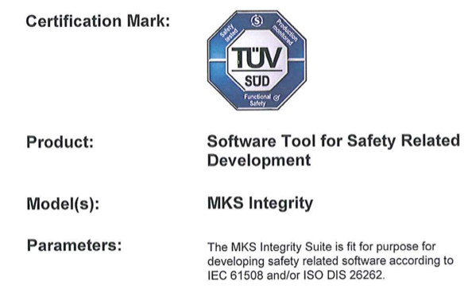
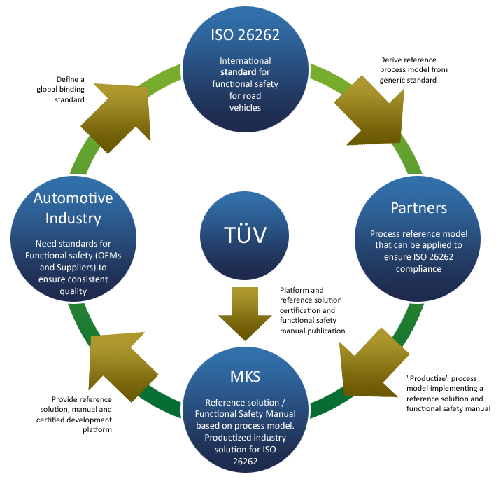

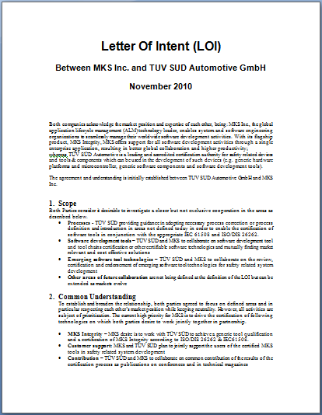

Functional Safety (ISO 26262)
Notes:
ISO 26262 is defined by functional safety managers from automotive industry. All OEMs and suppliers must be compliant when it is released as International Standard (Mid 2011).
TÜV qualifies Integrity according to the tool qualification requirements in ISO 26262 and provides a certificate for ISO 26262 and IEC 61508. The implementation techniques within the functional safety manual should also be certified for ISO 26262.
Integrity with the automotive functional safety reference solution and functional safety manual offers a solution to the automotive industry to enable them to be ISO 26262 compliant.

Slide 7
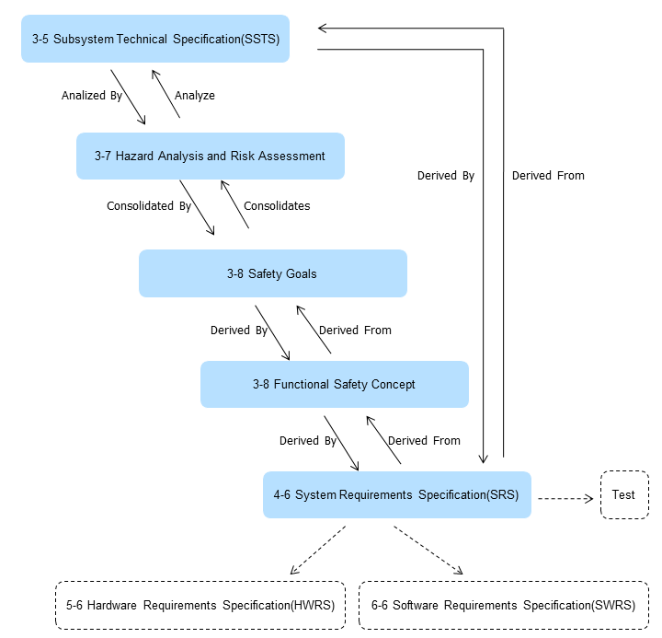
Rich Domain Model to Meet Requirements
Notes:
ISO 26262 is defined by functional safety managers from automotive industry. All OEMs and suppliers must be compliant when it is released as International Standard (Mid 2011).
TÜV qualifies Integrity according to the tool qualification requirements in ISO 26262 and provides a certificate for ISO 26262 and IEC 61508. The implementation techniques within the functional safety manual should also be certified for ISO 26262.
Integrity with the automotive functional safety reference solution and functional safety manual offers a solution to the automotive industry to enable them to be ISO 26262 compliant.

Slide 8
ISO 26262 - Breakdown
1. Vocabulary
2. Management of functional safety
2-5 Overall safety management
2-6 Safety management during item development
2-7 Safety management after release for
production
3. Concept phase
4. Product development: system level
7. Production and operation
3-5 Item definition
4-5 Initiation of product
development at the system level
4-11 Release for production
7-5 Production
3-6 Initiation of the safety lifecycle
4-10 Functional safety assessment
7-6 Operation, service
(maintenance and repair), and
decommissioning
4-6 Specification of the technical
safety requirements
4-9 Safety validation
3-7 Hazard analysis and risk assessment
4-7 System design
4-8 Item integration and testing
3-8 Functional safety concept
5. Product development:
hardware level
6. Product development:
software level
5-5 Initiation of product
development at the hardware level
6-5 Initiation of product
development at the softwarelevel
Core processes
5-6 Specification of hardware
safety requirements
6-6 Specification of software
safety requirements
5-7 Hardware design
6-7 Software architectural design
5-8 Hardware architectural metrics
6-8 Software unit design and implementation
5-9 Evaluation of violation of the safety goal due to random HW failures
6-9 Software unit testing
5-10 Hardware integration and testing
6-10 Software integration and testing
6-11 Verification of software safety requirements
8. Supporting processes
8-5 Interfaces with distributed developments
8-10 Documentation
8-6 Specification and management of safety requirements
8-11 Qualification of software tools
8-7 Configuration management
8-12 Qualification of software components
8-8 Change management
8-13 Qualification of hardware components
8-9 Verification
8-14 Proven in use argument
9. ASIL-oriented and safety-oriented analyses
9-5 Requirements decomposition with respect to ASIL tailoring
9-7 Analysis of dependent failures
9-6 Criteria for coexistence of elements
9-8 Safety analyses
10. Guideline on ISO 26262 (Informative)
Notes:
8

Slide 9





Process Control and Visualization – OEM View
OEM Deliverables
Vehicle Control System - Requirements
Validated and
Calibrated ECU
ECU
Requirements
“WHAT”
OEM
Validation and Calibration
Specification
“HOW”
HIL
Integration Test
Model
Source
Supplier
Delivers ECU and
HEX
Unit
Test
Supplier
Source & HEX

Slide 10
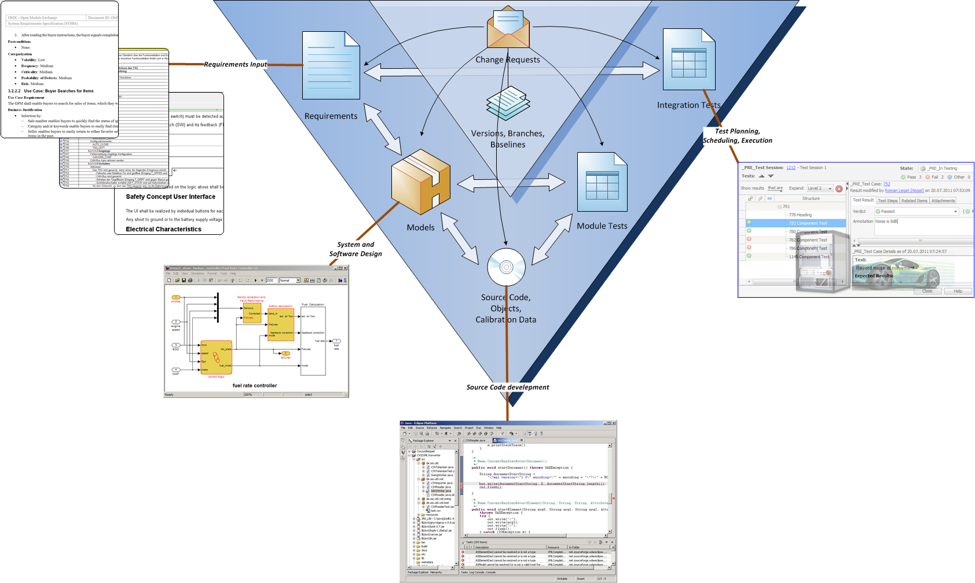

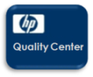















PTC’s ALM System
Unified Management Platform for Processes, Activities and Work Products

Slide 11
PTC Solutions - Multi-Discipline Systems Engineering
ITERATION
System Requirements Analysis
System-Release Test
System
level
System-Design
System-Integration & test
ITERATION
Mechanics-
Requirements
Analysis
Requirements
Analysis
& Design
SW
Requirements
IT-Integration
and -test
Cross Discipline Δ Management
Cross Discipline Δ Management
Subsystem
level
Mechanics-
integration and -test
Mechanics Design
HW-Analysis
& Design
SW-Analysis
& Design
SW-
Integration
and -test
HW-
Integration
and -test
Cross Discipline Δ Management
Cross Discipline Δ Management
SW-
Design
SW-
comp.-
test
Mechanics-
Implementation
Circuit Board Layout
HW-
Component test
Systems Domain
SW-Implemen-
tation
Mechanics-
component-Test
Software Domain
Component level
Cross Discipline Δ Management
Manufacturing
(Prototypes)
Electrical/Electronics Domain
Mechanical Domain
Tooling
Manufacturing
Mechanics-Module
SW/HW Integration Domain

Slide 12
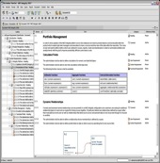
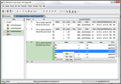
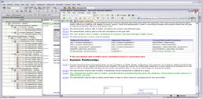
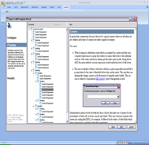
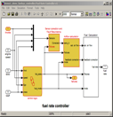
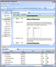
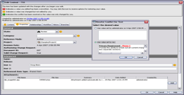
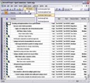
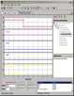
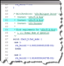
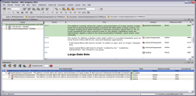
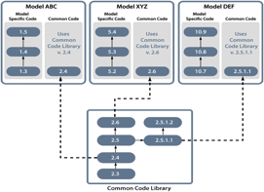
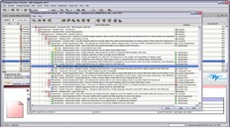
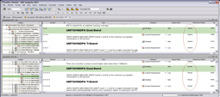
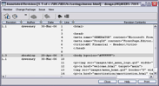
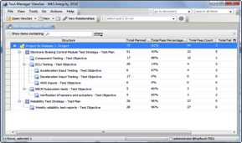
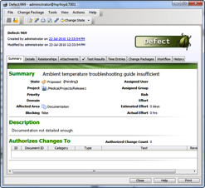
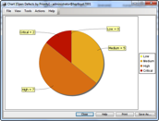
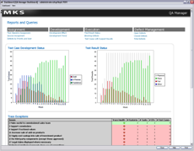
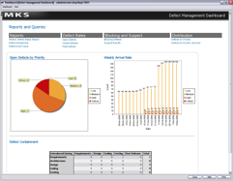
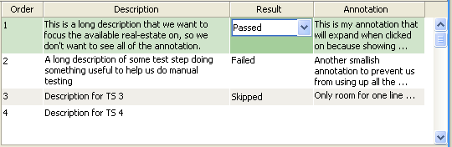
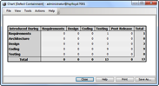
ALM Solution의 이해
Integrated Model Based Design
Comprehensive Change Management
Requirements Authoring
Model
Code
Variant Management - Reuse
Configuration Management
Full Lifecycle Traceability
Test Management
Defect Management
Real-Time Visibility and Metrics
Notes:
Requirements Authoring - Requirements elicitation, capture, and management is a critical process for any organization. Integrity has been touted as a leading requirements management solution for several years and has several differentiating capabilities:
Word-like document editing views
Sophisticated Word and Excel integrations
Lifecycle traceability from System Requirements to Code/CAD
Support for system, software and hardware requirements management
Integrated Model Based Design – MBD/MDD is a very important process for most automotive development groups. It has proven to be very effective in reducing development cycles, improving quality, and lowering costs. It has also been a very isolated practice, however, creating traceability, change management, and visibility challenges. Integrity harmonizes modeling with lifecycle management through key integrations with tools like Matlab/Simulink and Sparx Enterprise Architect.
Comprehensive Change Management – Managing the high velocity of software change as part of the overall enterprise engineering change management system is critical. Integrity handles change at high speed connecting all the relevant roles and artifacts together and driving the process through sophisticated workflow
Variant Management and Reuse – The automotive industry must support reuse and product lines like never before. Software provides more flexibility at lower costs and Integrity can manage the complexity of managing software product lines. Not only the code, but all artifacts from feature sets through to requirements, design, test, and code.
Configuration Management - Managing parallel software development is an important aspect of most development teams. Managing configurations for the entire set of ALM artifacts in an integral data model is unique to Integrity.
Lifecycle Traceability – Traceability is the key to solving many of the most complex development challenges facing automotive organizations. Organizations that use Integrity report their ability to manage change, automate impact analysis, track and report on compliance, coordinate complex processes, ensure collaboration across geographic boundaries is greatly enhanced because they have cross lifecycle visibility.
Test Management – Integrity provides development teams with visibility into test status and metrics, offline testing capability, and the ability to parameterize tests for greater reuse across product lines and configurations.
Defect Management – Integrity provides comprehensive defect management with a host of metrics and ability to easily relate defects to all applicable tests, test results, design elements, requirements, etc.
Real-time Visibility and Metrics – Integrity provides an extensive set of dashboards, charts, and reports that are updated in real-time. This provides all stakeholders instant visibility to make better decisions without affecting team productivity.

Slide 13
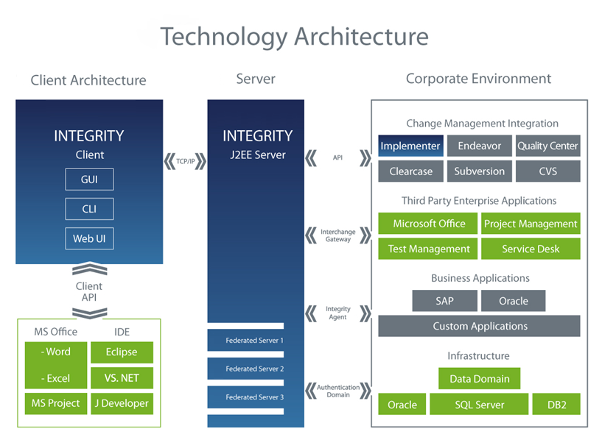
Integrity Architecture

Slide 14
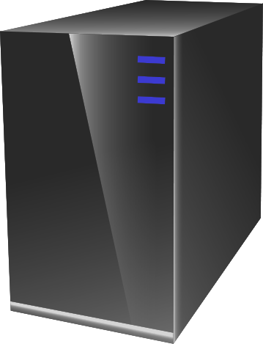
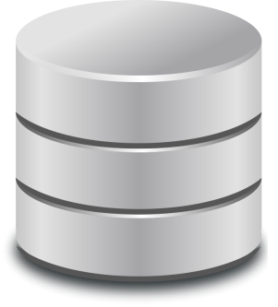
Staging Server Architecture
Administrator
Staging
Server
Prod
Server
Administrator
Administrator
Developers
Migration
Locked
Unlocked
Copy of
Production DB
Migration Wizard
Production DB

Slide 15
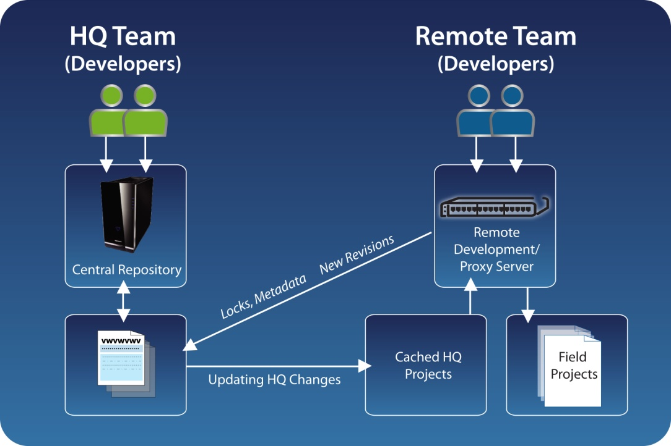
MKS Federated Server Architecture™
Enables global, real-time collaboration for geographically distributed software development teams
Intelligent local caching of source code and file attachment data
Overcomes limitations with bandwidth constrained or high latency networks
Leverages local development talent; “follow the sun” model, etc
Real-time access to Global ALM repository, independent of location
Improves virtual team collaboration
Better visibility across all activities and artifacts
Avoids coding conflicts, reducing likelihood of late- breaking integration efforts causing project disruption

Slide 16
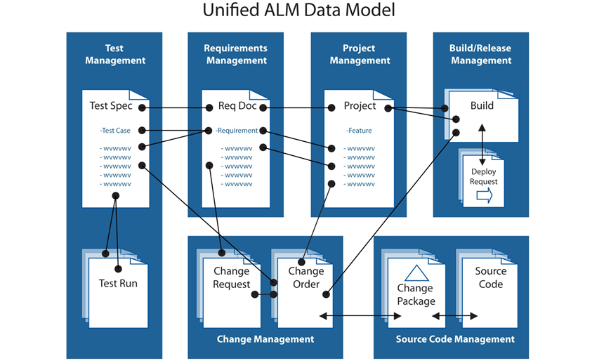
ALM Data Model

Slide 17


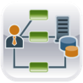
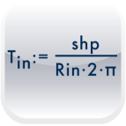





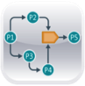



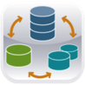


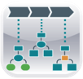


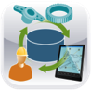
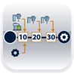
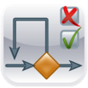




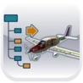
PTC’s Product Development System
– Updated
Program Portfolio Mgt.
Requirements Management
System Modeling
Engineering Calculations
MCAD / CAM / CAE
ECAD
Software Management
ERP
Product Lifecycle Management
Document Management
Distributed Collaboration
Workflow
Heterogeneous CAD Data Mgmt
ECAD Data Management
Financials
SCM
Enterprise Interoperability
MRP
Business Reporting
Social Product Development
Change & Config. Mgmt
Complete BOM Management
Visualization
Service Information
Manufacturing Process Mgt.
Test Management
Quality, Risk & Reliability Mgt.
Product Analytics
Supplier Management
Component Management
Digital Mockup
Added with Integrity
Notes:
The version of the racetrack without Integrity capabilities shows gaps, Integrity fills those gaps to uniquely complete the PDS to include software
Integrity is an integral component of PTC’s product development system or PDS. You’ve seen this graphic representation of the PTC’s PDS, presenting our best-of-breed applications that all work well together, helping our customers to optimize their product development processes. The capabilities in the center are core PLM capabilities and the ones on the outside are extended capabilities. The Integrity product has provided significant capabilities to the PTC product lifecycle management backbone.
(A1) First, with its inherent ability for Integrity to manage the change and configuration and collaboration of source code and software, Integrity has added Software Management. (A2) Next, Integrity has added Requirements Management, which will be integrated deeply into Windchill to provide the management, change and configuration, and collaboration of requirements not only for Integrity and part of the SSLM, but also as part of the entire PDS by managing requirements for Windchill. (A3) Integrity has also added System Modeling, the ability for Integrity to manage and trace various software artifacts. (A4) And finally, due to Integrity, Test Management is now part of the PTC PDS, which includes all aspects of managing tests of software artifacts, as well as of the other artifacts included within Windchill.
So while it’s important to recognize that of course integrity is one product for SSLM, it can also be used in various different components for requirements or system modeling or test management or software change and configuration management as included within the entire product lifecycle management solution.

Slide 18
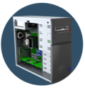


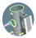





Integrity + Windchill: A Powerful Combination!
Desktop
Historically, PLM solutions only included end product/deliverable software in the BOM, lacking traceability from requirements to source code and test artifacts
Housing
Battery
Viewable
Display
Requirements
LED
CAD model
Integrity allows global access to a single, accurate source of detailed software lifecycle artifacts
PCA
Data sheet
Schematic
Analysis
Bare board
Test plan
Component
ASIC Comp
Firmware assembly
Component
Requirements
Software
HDL/LLD
Software
Software
Executables
C++
Source code
Test Artifacts
Notes:
Our customers see the Bill of Materials, or BOM, as the center of their product development universe. With the integration of Integrity and Windchill, PTC has the only product on the market today that has a complete Bill of Materials across hardware AND software. Historically, PLM solutions have only included end product software in the BOM, preventing traceability from requirements to source code and test artifacts. Integrity now delivers global access to a single, accurate source of detailed software lifecycle artifacts, providing significant differentiation for PTC regarding software management as part of the overall PLM solution.

Slide 19
추적성 (Traceability)
Change Request란?
수정 요청 항목임
프로젝트 선택 할 수 있음
현재 상태를 알 수 있는 State를 가지고 있음
모든 항목과 연계되어 있음
사용자 또는 사용자그룹 지정
Change
Request
Requirements
Validation
Tests
Specifications
Verification
Tests
Models
Model Tests
Source

Slide 20
요구사항 관리
요구사항 관리

Slide 21
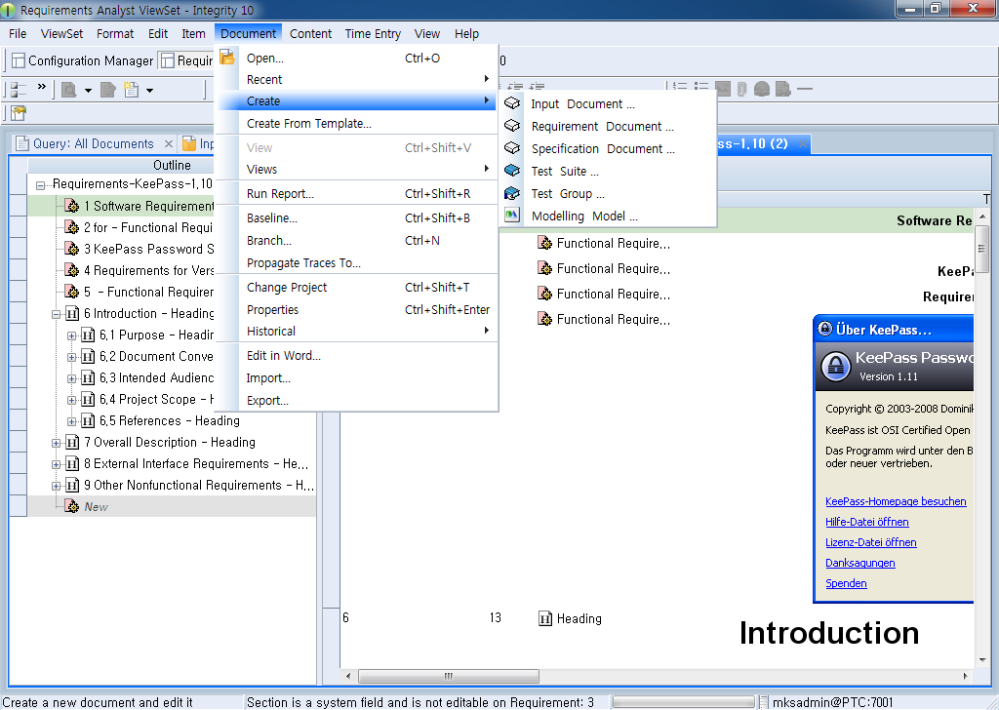
요구사항 관리 (Requirement Management)
Authoring (문서 생성)
Integrity에서 여러 개의 문서 생성 가능.
Word로 Template을 생성 후 Template을 이용하여 문서 생성 가능.
새로운 문서 타입의 손쉬운 추가 및 연계

Slide 22




요구사항 관리 (Requirement Management)
Authoring (문서 생성)
Re-Import
Import
Export

Slide 23
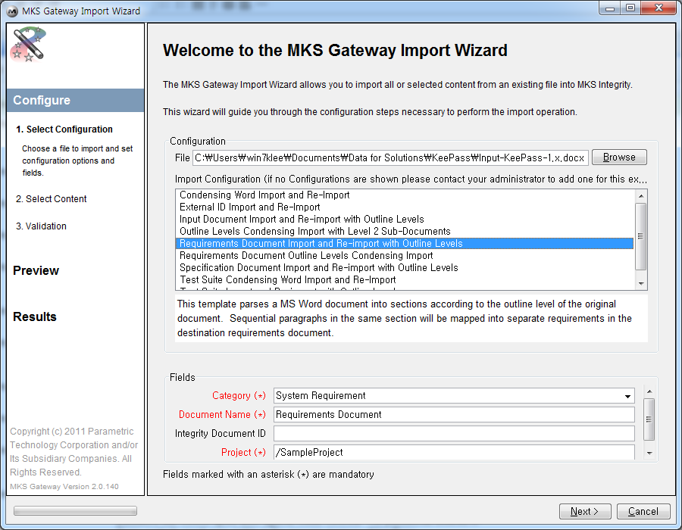
요구사항 관리 (Requirement Management)
Import (MS Word)
Integrity의 Gateway를 사용하여 MS word Import 가능.
Import할 MS Word 선택.
Import Configuration 선택.(Initial Import / Reimport). 필요한 항목 추가 가능. (XML 수정)
Field에서 문서내 각 항목의 Category와 문서 이름, 프로젝트 이름 입력 및 선택
Re-Import일 경우 다시 Import할 Document ID 입력
1
2
3
4
5

Slide 24
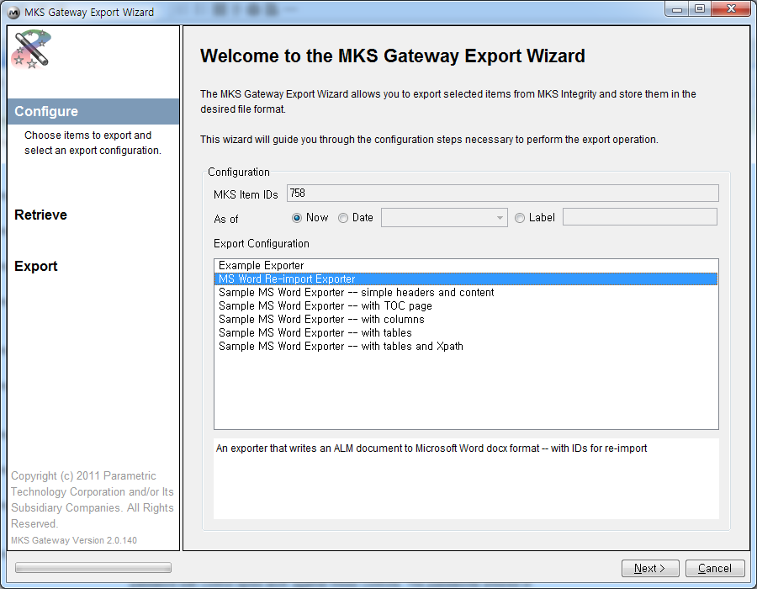
요구사항 관리 (Requirement Management)
Export (MS Word)
Integrity의 Gateway를 사용하여 MS word Export 가능.
Export될 문서의 ID가 자동으로 표시됨. Read-only.
Export Configuration 선택. 원하는 Template으로 Export 가능.
필요한 항목 추가 가능. (XML 수정)
1
2
3
4

Slide 25
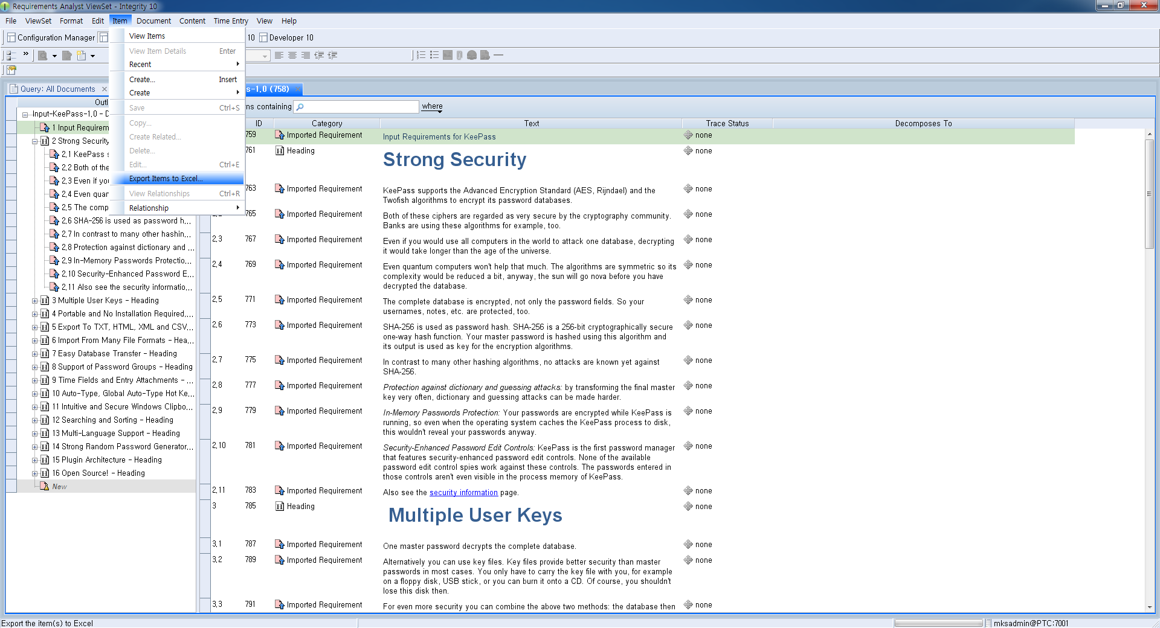
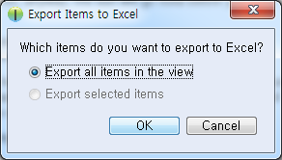
요구사항 관리 (Requirement Management)
Export (MS Excel)
Integrity의 Export Items to Excel 선택
Integrity 내 모든 문서를 MS Excel로 OOTB로 바로 사용 가능.
선택 항목 또는 전체 항목에 대한 MS Excel Export 가능.
1
3
2

Slide 26

요구사항 관리 (Requirement Management)
Re-Import (MS Word)
Re-Import 시 Integrity의 문서와 Import 문서의 Difference를 볼 수 있음.
나머지는 Import 순서와 동일 함.
1

Slide 27

요구사항 관리 (Requirement Management)
Editing
문서내의 각 항목마다 Category를 지정 할 수 있음. 원하는 Category의 추가/수정/삭제 가능함.
각 사용자마다 원하는 Column을 추가/삭제 가능함
기존 MS Word 및 Excel과 동일한 방법으로 문서를 작성 할 수 있음. 동일한 UX를 제공해 줌으로써 쉽게 문서를 작성/수정 할 수 있음.
문서내부에서
장 / 절 / 항목을 기본적으로 제공
문서내에 image / Link / Table / OLE / URL 등의 객체 등을 삽입 할 수 있음.
영문 및 한글 입력 가능함.

Slide 28









요구사항 관리 (Requirement Management)
FMEA
Traceability (문서간의 추적성)
Input
Hazards Analysis
Specification
Mitigated By
Mitigated By
Validated By
Decomposes To
Mitigated By
Satisfied By
Verified By
Software Code
Results
Verified By
Results
Validation Tests
Requirements
Verification Tests

Slide 29

요구사항 관리 (Requirement Management)
Traceability (문서간의 추적성)
Document 종류/이름/ID 확인 가능
문서내의 각 항목마다 Trace 연결이 되어 있는지 없는지 바로 확인 할 수 있음.
Trace 연결이 되어있는 항목을 선택 시 자동으로 추적성이 연결되어 있는 항목들이 Tree View 형태로 보여짐.

Slide 30


요구사항 관리 (Requirement Management)
Branch & Baseline (문서 Version Control)
문서 Baselining시 기존에 생성되었던 Label 또는 수정 내역 / 날짜 / 현재시간에 따라 문서의 Baselining을 할 수 있음.
Baseline과 Branch 메뉴를 사용하여 문서의 버전 관리 가능

Slide 31



요구사항 관리 (Requirement Management)
Reuse / Share / Author

Slide 32
프로젝트 관리
프로젝트 관리

Slide 33

프로젝트 관리 (Project Management)
Integrated to

Slide 34
프로젝트 관리 (Project Management)
Integration Microsoft Project with Integrity
Creation of new Integrity items from Microsoft Project tasks
Creation of new Microsoft Project tasks from existing Integrity items returned in a query
Synchronization of selected or linked tasks
Conflict detection for resources or field contents

Slide 35
프로젝트 관리 (Project Management)
Project A
Project B
Project C
Parent Project
Parent Project
Project A
Child Project
Child Project
Child Project
Child Project
Child Project
Project B
Child Project
Child Project
Child Project
Child Project
Child Project
Child Project
Child Project
Child Project
Child Project

Slide 36



프로젝트 관리 (Project Management)
User Client > Item > Create > Project 메뉴를 실행하여 Project Item을 생성 할 수 있음.
Admin User Client > Workflows and Documents > Project > Create Backing Item 메뉴를 실행하여 Project Item을 생성 할 수 있음.
1
1
Summary Tab
1
신규 Project 생성 시 Project의 Backing Item을 생성하여 Project 관리를 할 수 있음
2
Project 선택
2
빨간색은 필수 입력 항목임.
Admin이 필수 입력항목의 추가 및 변경 가능함

Slide 37



프로젝트 관리 (Project Management)
Schedule & Budget Tab
1
Project 시작 날짜와 실제 프로젝트가 실행되는 날짜 및 Project 계획에 대한 날짜를 입력 할 수 있음.
1
Project의 Schedule 및 Budget등을 Project 생성 시 입력 및 변경하여 Project를 효율적으로 관리 할 수 있음.
Properties Tab
Project의 속성을 주어 Project의 기능을 제한할 수 있음.

Slide 38

프로젝트 관리 (Project Management)
1
다양한 Metrics 항목들을 제공하여 프로젝트 수행 시 생성된 Activity, Change Request, Defects, Test Session등이 자동으로 계산되어 보여지는 기능을 제공.
현재 미해결된 사항들 및 프로젝트 수행 시 발생된 요구사항 문서의 개수를 자동으로 계산하여 보여지는 기능 제공
프로젝트 수행 시 진행된 테스트 결과를 자동으로 계산하여 보여지는 기능 제공.
Metrics Tab
1
2
2
3
3

Slide 39



프로젝트 관리 (Project Management)
Relationship Tab
Attachments Tab
프로젝트와 관련된 파일을 추가하여 관리 할 수 있음.
+ 아이콘 선택 시 파일 선택하는 창이 나타남. 추가할 파일 선택 후 OK

Slide 40


프로젝트 관리 (Project Management)
Parameters Tab
Workflow Tab
Project의 WorkFlow를 제공하여 현재 Project의 State를 볼 수 있음.
또한 WorkFlow의 수정이 가능함.

Slide 41
변화 관리
1. ISO 26262 Mapping
2. 변화 관리
3. Issue Tracking
4. 결함 관리

Slide 42
ISO 26262 Mapping
1. Vocabulary
2. Management of functional safety
2-5 Overall safety management
2-6 Safety management during item development
2-7 Safety management after release for
production
3. Concept phase
4. Product development: system level
7. Production and operation
3-5 Item definition
4-5 Initiation of product
development at the system level
4-11 Release for production
7-5 Production
3-6 Initiation of the safety lifecycle
4-10 Functional safety assessment
7-6 Operation, service
(maintenance and repair), and
decommissioning
4-6 Specification of the technical
safety requirements
4-9 Safety validation
3-7 Hazard analysis and risk assessment
4-7 System design
4-8 Item integration and testing
3-8 Functional safety concept
5. Product development:
hardware level
6. Product development:
software level
5-5 Initiation of product
development at the hardware level
6-5 Initiation of product
development at the softwarelevel
Core processes
5-6 Specification of hardware
safety requirements
6-6 Specification of software
safety requirements
5-7 Hardware design
6-7 Software architectural design
5-8 Hardware architectural metrics
6-8 Software unit design and implementation
5-9 Evaluation of violation of the safety goal due to random HW failures
6-9 Software unit testing
5-10 Hardware integration and testing
6-10 Software integration and testing
6-11 Verification of software safety requirements
8. Supporting processes
8-5 Interfaces with distributed developments
8-10 Documentation
8-6 Specification and management of safety requirements
8-11 Qualification of software tools
8-7 Configuration management
8-12 Qualification of software components
8-8 Change management
8-13 Qualification of hardware components
8-9 Verification
8-14 Proven in use argument
9. ASIL-oriented and safety-oriented analyses
9-5 Requirements decomposition with respect to ASIL tailoring
9-7 Analysis of dependent failures
9-6 Criteria for coexistence of elements
9-8 Safety analyses
10. Guideline on ISO 26262 (Informative)

Slide 43
ISO 26262 Part 8-8 Change Management Reference
Change management plan: When to start the process. Which work products. Change process for each work product. Change request includes: - Unique identifier - Date - Reason for the requested change - Exact description of the requested change - Configuration on which it is based Potential impacts on functional safety shall be assessed - Changed work products require returning to applicable phase Decision-making process for changes required Basis: Change request, impact analysis Acceptance, rejection, delay Authorized persons from the parties involved, typically: - Project manager - safety manager - quality assurance - Developers Implementation of changes Only accepted changes In case of impact on safety functions: Assessment prior to release Documentation necessary including changed work products and planned deployment

Slide 44

변화 관리 (Change Management)
User Client > Item > Create > Change Request 메뉴를 통해 Change Request Item 생성
<Change Request 생성 목적>
문서 수정이 필요한 경우
소스코드 변경이 필요한 경우
테스트를 실행 할 경우
결함이 발견되어 수정요청이 필요한 경우

Slide 45


변화 관리 (Change Management)
Properties Tab
+ 아이콘 선택 시 파일 선택하는 창이 나타남. 추가할 파일 선택 후 OK
Change Request 관련된 파일을 추가하여 관리 할 수 있음.
Change Request의 WorkFlow를 제공하여 현재 Change Request의 State를 볼 수 있음.
또한 WorkFlow의 수정이 가능함.
Workflow Tab

Slide 46


변화 관리 (Change Management)
Defect Item 생성
Create Related Item Icon

Slide 47
변화관리 (Activity For Requirement Management)
Change Request
Activity
Requirements
Specifications
Models
*Activity의 State : In Progress *Document의 State : Accepted
ALT + Drag & Drop
한 개의 Activity로 여러 개의 문서의 권한 부여 가능.
Activity안의 Assigned User만이 Activity와 연계된 문서의 수정 권한 생김.
Activity는 Change Request와 연결되어짐.

Slide 48
변화관리 (Activity For Test Management)
Change Request
Activity
Model Tests
Verification Tests
Validation Tests
*Activity의 State : In Progress *Document의 State : Accepted
ALT + Drag & Drop을 사용하여 문서에 Activity 권한 부여.
한 개의 Activity로 여러 개의 문서의 권한 부여 가능.
Activity안의 Assigned User만이 Activity와 연계된 문서의 수정 권한 생김.
Activity는 Change Request와 연결되어짐.

Slide 49
변화 관리 (Activity For Configuration Management)
Change Request
Change Request
Activity
Change Package
Check In
Check Out
Add Member
Drop Member
Create Sandbox
Source Codes
Version Control

Slide 50
변화 관리 (Activity For Test Management)
Result
Editor
Change Request
Test Result
Test Fail
Activity
Test Fail
Defect
Test 결과가 Fail일 경우 Change Request 또는 Defect Item을 생성

Slide 51

이슈 트렉킹 (Issue Tracking)
OEM
요구사항 관리자
개발자
테스트 엔지니어
Defect
Change Request
Activity
Requirements
Validation
Tests
Specifications
Verification
Tests
Models
Model Tests
Source

Slide 52






Change Management (Defect/Issue) in ALM
1
Link to Change Request
Register External Issue
3
Issue
Issue
Defect
Issue
Defect
Issue
Defect
Issue
…..
Issue
2
…..
Register as Defect By CCB
Issue
1
Register Internal Issue
Integrity

Slide 53
Defect / Issue Management with PLM
PLM
1
Register External Issue
Link to Change Request
4
Link to PLM
3
Issue
Issue
Defect
Issue
Defect
Issue
Defect
Issue
…..
Issue
2
…..
Register as Defect By CCB
Issue
1
Register Internal Issue
Integrity

Slide 54

결함 관리 (Defect Management)
User Client > Item > Create > Defect 메뉴를 통해 Defect Item 생성

Slide 55


결함 관리 (Defect Management)
Properties Tab
Assigned User Field. 담당자 지정
Project Field. 프로젝트 선택
Description Field. 결함 생성의 원인 및 설명
Metrics Tab
Computing Field. 결함이 발생하여 해결 되기까지 의 시간 및 그 기간 동안 생성된 Change Package의 개수 및 정보를 제공

Slide 56


결함 관리 (Defect Management)
Defect Item 생성 후 Relationships 탭에서 Defect와 관련된 Item인 Change Request를 Defect Item에서 생성할 수 있음.
Relationships Tab.
Create Related Item Icon
Change Request 생성

Slide 57


결함 관리 (Defect Management)
Attachments Tab
결함과 관련된 파일을 추가하여 관리 할 수 있음.
+ 아이콘 선택 시 파일 선택하는 창이 나타남. 추가할 파일 선택 후 OK
Defect Item의 WorkFlow를 제공하여 현재 Defect Item의 State를 볼 수 있음.
또한 WorkFlow의 수정이 가능함.
Workflow Tab

Slide 58
테스트 관리
테스트 관리

Slide 59
테스트 관리 (Test Management)
Test Case
Test Case
Test Step
Test Step
Test Case
Test Step
Test Step
Test Step
Test Step
Test Step
Test Step
Test Step
Test Step
Test Step
Test Step

Slide 60
테스트 관리 (Test Management)
Test suite
Test suite
Test Case
Test Case
Test Step
Test Step
Test Step
Test Step
Test suite
Test Step
Test Step
Test Step
Test Step
Test Case
Test Case
Test Step
Test Step
Test Step
Test Step
Test Case
Test Case
Test Step
Test Step
Test Step
Test Step
Test Case
Test Case
Test Step
Test Step
Test Step
Test Step
Test Step
Test Step
Test Step
Test Step
Test Step
Test Step
Test Step
Test Step
Test Case
Test Case
Test Step
Test Step
Test Step
Test Step
Test Step
Test Step
Test Step
Test Step
Test Case
Test Case
Test Step
Test Step
Test Step
Test Step
Test Case
Test Case
Test Step
Test Step
Test Step
Test Step
Test Step
Test Step
Test Step
Test Step
Test Step
Test Step
Test Step
Test Step
Test Case
Test Case
Test Step
Test Step
Test Step
Test Step
Test Step
Test Step
Test Step
Test Step
Test Step
Test Step
Test Step
Test Step
Test Case
Test Case
Test Step
Test Step
Test Step
Test Step
Test Step
Test Step
Test Step
Test Step

Slide 61
테스트 관리 (Test Management)
Test suite
Test Session
Test Session
Test suite
Test Session
Test Case
Test Case
Test Case
Test Case
Test Step
Test Step
Test Step
Test Step
Test Step
Test Step
Test Step
Test Step
Test Case
Test Case
Test suite
Test Step
Test Step
Test Step
Test Step
Test Step
Test Step
Test Step
Test Step
Test Case
Test Case
Test Case
Test Case
Test Step
Test Step
Test Step
Test Step
Test Step
Test Step
Test Step
Test Step
Test Step
Test Step
Test Step
Test Step
Test Step
Test Step
Test Step
Test Step
Test Case
Test Case
Test Step
Test Step
Test Step
Test Step
Test Step
Test Case
Test Case
Test Step
Test Step
Test Step
Test Step
Test Step
Test Step
Test Step
Test Case
Test Case
Test Case
Test Case
Test Step
Test Step
Test Step
Test Step
Test Step
Test Step
Test Step
Test Step
Test Step
Test Step
Test Step
Test Step
Test Step
Test Step
Test Step
Test Step
Test Case
Test Case
Test Step
Test Step
Test Step
Test Step
Test Step
Test Step
Test Step
Test Step
Test Step
Test Step
Test Case
Test Case
Test Step
Test Step
Test Step
Test Step
Test Step
Test Step
Test Step
Test Step
Test Step
Test Step
Test Step
Test Step
Test Step
Test Step
Test Case
Test Case
Test Step
Test Step
Test Step
Test Step
Test Case
Test Case
Test Step
Test Step
Test Step
Test Step
Test Step
Test Step
Test Step
Test Step
Test Step
Test Step
Test Step
Test Step
Test Case
Test Case
Test Step
Test Step
Test Step
Test Step
Test Step
Test Step
Test Step
Test Step
Save the Test
Results to Test Session
Test Case
Test Case
Test Step
Test Step
Test Step
Test Step
Test Step
Test Step
Test Step
Test Step
Test Result
Test Step
Test Step
Test Step
Test Step
Result
Editor
Automatic
Manual
Test Case
Test Case
Test Step
Test Case
Test Step
Test Step
Test Step
Test Fail
Test Step
Test Step
Test Step
Test Step
Change Request
Test Step
Test Step
Test Step
Test Step
Activity
Notes:
Automatic : ATEF (Automatic Test Execution Framework).

Slide 62

테스트 관리 (Test Management)
Test Event 등록 (Test Session) / 수정 / 삭제 / 조회 가능합니다.
Test Session
Test Case

Slide 63

테스트 관리 (Test Management)
Test Case 관리
Test Case / 등록 / 수정/ 삭제 / Excel Export가 가능합니다.
workflow : Test Suite 생성 – Test Case 작성 – Test(자동/수동) 후 Test 결과 입력
Test Suite
Test Case
Test Case
Test Result
Test Case
Test Result

Slide 64
툴 체인
툴 체인

Slide 65












Tool Chain Architecture
LDAP/
Active Directory
MS Word
MS Excel
MS Project
dSpace
Jenkins
Mathworks
MS VS
eclipse
Integrity (Client / Server)
PLM System
RIF
DanTe
Perforce
Subversion
ClearCase
IIP (Web Services & Adapter API)
PDM System
ReqIf
ASAM
RSA
IBM Doors
JIRA
ClearQuest
Sparx EA
Quality Center
Tools’ Server

Slide 66
Tool Chain Architecture
LDAP/
Active Directory
MS Word
MS Excel
MS Project
dSpace
Jenkins
Mathworks
MS VS
eclipse
Integrity
IIP (Integrity Integration Platform)
PLM System
RIF
DanTe
Perforce
Subversion
ClearCase
Application
PDM System
ReqIf
ASAM
RSA
IBM Doors
JIRA
ClearQuest
Sparx EA
Quality Center

Slide 67





Architecture
Support Platform
Integrity가 지원하는 Server 와 Client OS 지원 환경 및 3 Party Matrix 입니다.
Integrity Server Supported Operating Systems
Integrity Installers (32- and 64-bit)
Integrity Supported Databases
Integrity Client Supported Operating Systems
Integrity Supported Browsers

Slide 68
Performance
성능요구 사항에 대한 사례를 하기와 같이 제시하며, 당시 이용된 Server사양은 아래와 같습니다.
Category | Number | Remarks
Registered Users | 1000 | Integrity is tested against 15,000 registered Users.
Organization | Hundreds | There is no Limit in Organizations using Integrity
Concurrent Users | 100 | Integrity is tested against 2,500 concurrent Users
Registered Issue | 1,000,000 | As long as the underlying Database has the Performance, there is no Limit for Integrity
Oracle Database Server
Sun Server M4000
4x4 CPU Cores
16 GB Memory
Sun Solaris 10 (5.10)
Oracle 11G R2
Federated Server
Winders Server 2008 64bit
16 GB Memory
150GB Harddisk
►(Preferably fast like 15.000rpm)
Integrity Server
Windows Server 2008 R2 Enterprise 64 bit
16 GB Memory
4x4 CPU cores
150 GB Harddisk Space

Slide 69
Reference
글로벌 자동차 부품업체 순위(2010년)
순위 | 업체명(국가) | 연매출(달러)
1 | 보쉬(독일) | 345억5500만
2 | 덴소(일본) | 328억5000만
3 | 콘티넨탈(독일) | 248억1900만
4 | 아이신정기(일본) | 246억1300만
5 | 마그나(캐나다) | 236억
6 | 포렌시아(프랑스) | 182억2000만
7 | 존슨콘트롤(미국) | 166억
8 | ZF(독일) | 157억4800만
9 | LG화학(한국) | 155억
10 | 현대모비스(한국) | 144억3300만
Integrity 사용 회사

Slide 70

Reference
PTC는 전기 전자, 자동차, 메디컬, 통신 분야에 걸쳐 다양한 고객 사례를 가지고 있으며, 특히 복잡성이 매우 높은 제조업에서 성공적인 구축 사례를 가지고 있습니다.

Slide 71
Why Integrity?
한 개의 Database를 사용한다.
한 개의 Source Code
각 관리 항목에 대한 별도의 연계가 필요 없음
한 개의 Solution안에 모든 기능 제공
요구사항 / 변화 / 소스코드 / 테스트 / 빌드 / 릴리즈 / 결함 / Portfolio 관리 등등.
Embeded Software에 초점을 맞추어 개발 되어짐. (수많은 레퍼런스)
초기부터 협업 가능한 제품에 초점을 맞추어 개발 되어짐.
제품의 주요 특징
GUI / CLI / Web UI 모두 제공
요구사항의 무한 Reuse (재 사용시 Copy 하지 않음)
Authoring
Doors 문서 migration가능
MS 제품 (Word, excel..) 의 Import / Export / Re-import 기능 제공
다양한 Report / Dashboard / Chart 기능 제공
각 항목의 추가가 용이하며, 개수에 제한이 없음

Slide 72
Why Integrity? contd…
4. 추적성
각 관리 항목마다 1대 N의 추적성 연결이 용이하다.
문서 대 문서 뿐만 아니라, 문서내의 Item 대 Item의 추적성 연결이 가능하다.
문서내의 추적성이 연결된 Item의 Trace Status를 쉽게 추적을 할 수 있는 UI를 제공한다.
Integrity 안에 있는 모든 항목에 대해 연결이 가능하다.
Suspect Link제공 (추적성이 연결된 항목 중 상위 항목이 바뀌었을 때 추적성에 대한 Review및 수정된 곳을 찾는 것이 용이)
5. 동일한 사용자 환경 제공
한 개의 제품안에 모든 관리 항목이 기 개발 되어 있어, 각 항목마다 툴을 익힐 필요가 없다.
6. 사용자 별 권한 부여 가능
Role Base로 권한 부여가 가능.
R&R에 따른 다른 메뉴 및 다른 환경 제공 가능

Slide 73
Why Integrity? contd…
7. 제품의 확장성.
항목의 workflow 수정을 별도의 Tool을 사용하지 않고 내부에서 Configuration 가능
항목의 UI 수정을 별도의 Tool을 사용하지 않고 내부에서 Configuration 가능
C APIs 와 Java API를 제공함으로써 in-house tool에 대한 연계 용이
필요한 메뉴의 확장 가능 (소스 코드를 이용해 메뉴 구현 후 Integrity에 연계 용이)

